Slide 1





Interest Calculations – II
(Problems based on installments- CI & SI)

Slide 2
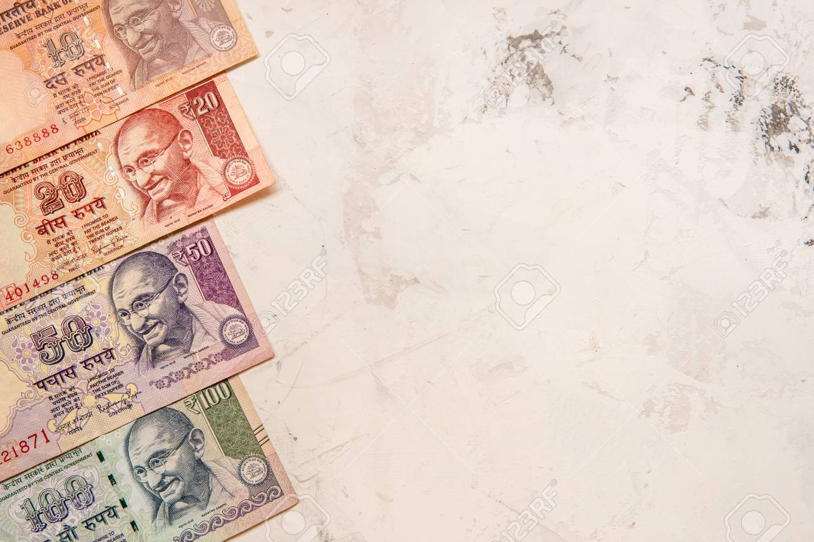




A = P + S.I
Installment:
What’s an installment?
It is the sum of money due as one of the several payments for something, spread over an agreed period of time. So if you buy a TV and you don’t have enough money to pay for it completely, you may agree on giving a certain money at the end of every month which will over a period of time compensate for your choice of not paying it in a one go.
What is Down payment?
It is the amount that is paid initially while buying the article. Rest is paid in form of installment and an interest on it.

Slide 3

A = P + S.I
To calculate the installments paid with simple interest, we use the following formula:
SIMPLE INTEREST
Amount $=$ P + $\frac{P ×T×R}{100}$
If monthly installment is there (with down payment), then
P + $\frac{P ×T×R}{100×12}$ = x + $\frac{x×(T−1)×R}{100×12}$ + x + $\frac{x×(T−2)×R}{100×12}$+ x + $\frac{x×(T−3)×R}{100×12}$ + …….. + x
For yearly installment with down payment,
P + $\frac{P ×T×R}{100}$ = x + $\frac{x×(T−1)×R}{100}$ + x + $\frac{x×(T−2)×R}{100}$+ x + $\frac{x×(T−3)×R}{100}$ + …….. + x
Where,
P= Principal
R=rate of interest
T= number of installments
x= Amount of installment

Slide 4

A = P + S.I
To calculate the installments paid with compound interest, we use the following formula:
SIMPLE INTEREST
SHORTCUT FORMULA:
The annual payment discharged while paying a debt of Rs. A due in n years at the rate of interest r% per annum is
$=$ $\frac{100A}{100n+\frac{rn(n−1)}{2}}$

Slide 5

A = P + S.I
To calculate the installments paid with compound interest, we use the following formula:
COMPOUND INTEREST
Compound Interest is the interest calculated on the initial principal and the accumulated interest of previous periods of a deposit or loan. In easy words, it can be said as "interest on interest".
Amount $=P\left(1+\frac{R}{100} \right)n$
$P\left(1+\frac{R}{100} \right)n$ = x$\left(1+\frac{R}{100} \right)n$ ⁻¹ $+x\left(1+\frac{R}{100} \right)n$ ⁻² + x$\left(1+\frac{R}{100} \right)n$ ⁻³ $+$………. + x
Where,
P= Principal
R=rate of interest
n= number of installments
x= Amount of installment

Slide 6

A = P + S.I
Four equal installments, each of Rs. 500, were paid at the end of the year on a sum borrowed at 10% compounded annually. Find the sum (correct up to 2 decimal place).
Compound Interest is the interest calculated on the initial principal and the accumulated interest of previous periods of a deposit or loan. In easy words, it can be said as "interest on interest".
Solution:
Rate= 10%
Installment = Rs.500
Principal=?
Putting these values in the formula:
$P\left(1+\frac{R}{100} \right)n$ = x$\left(1+\frac{R}{100} \right)n$ ⁻¹ $+x\left(1+\frac{R}{100} \right)n$ ⁻² + x$\left(1+\frac{R}{100} \right)n$ ⁻³ $+$………. + x
$P\left(1+\frac{10}{100} \right)4$ = 500$\left(1+\frac{10}{100} \right)$³ $+500\left(1+\frac{10}{100} \right)$² + 500$\left(1+\frac{10}{100} \right)1$ + 500
P(1.1)⁴ = 500(1.331) + 500 (1.21) + 500(1.1) + 500
1.4641P = 500(3.641)
P = Rs. 1584.93

Slide 7

A = P + S.I
Rahul takes a loan of Rs 150000 at an interest rate of 20% compound interest, which is compounded annually. He agrees to pay three equal installments in three years, one installment at the end of every year. Find the value of each installment.
Compound Interest is the interest calculated on the initial principal and the accumulated interest of previous periods of a deposit or loan. In easy words, it can be said as "interest on interest".
Solution:
Rate= 20%
Installment = Rs.x
Principal=Rs.150000
Putting these values in the formula:
$P\left(1+\frac{R}{100} \right)n$ = x$\left(1+\frac{R}{100} \right)n$ ⁻¹ $+x\left(1+\frac{R}{100} \right)n$ ⁻² + x$\left(1+\frac{R}{100} \right)n$ ⁻³ $+$………. + x
150000$\left(1+\frac{20}{100} \right)3$ = X$\left(1+\frac{20}{100} \right)$² $+X\left(1+\frac{20}{100} \right)$¹ + X
X = Rs. 71209

Slide 8


A = P + S.I
What annual installment will discharge a loan of Rs. 832 due in 2 yrs @ 8%pa?
Compound Interest is the interest calculated on the initial principal and the accumulated interest of previous periods of a deposit or loan. In easy words, it can be said as "interest on interest".
Solution:
If Principal = x
x+1.08x= 2.08x=832
x=400
Using the formula, annual installment= $\frac{100A}{100n+\frac{rn(n−1)}{2}}$
$$\frac{100 ∗832}{100 ∗2+\frac{8∗2∗1)}{2}}$$
= 400
OR

Slide 9

A = P + S.I
Calculate the amount of equal installment, which will discharge a debt of Rs. 4240 due in 4 years at 4% p.a. of simple interest.
Compound Interest is the interest calculated on the initial principal and the accumulated interest of previous periods of a deposit or loan. In easy words, it can be said as "interest on interest".
Solution:
Using the formula, annual installment= $\frac{100A}{100n+\frac{rn(n−1)}{2}}$
$$\frac{100 ∗4240}{100 ∗4+\frac{(4∗4∗3)}{2}}$$
= Rs. 1000

Slide 10

A = P + S.I
A device is available for Rs 5000 cash or Rs 500 down payment followed by 4 equal installments. If the rate of interest charged is 25% per annum simple interest, calculate the monthly installment.
Compound Interest is the interest calculated on the initial principal and the accumulated interest of previous periods of a deposit or loan. In easy words, it can be said as "interest on interest".
Solution:
P + $\frac{P ×T×R}{100×12}$ = x + $\frac{x×(T−1)×R}{100×12}$ + x + $\frac{x×(T−2)×R}{100×12}$+ x + $\frac{x×(T−3)×R}{100×12}$ + …….. + x
After paying a down payment of 500 amount to be paid will be 5000-500=4500
Total amount of installments for 4 months will be
4500 + $\frac{4500 ×4×25}{100×12}$ = x + $\frac{x×(3)×25}{100×12}$ + x + $\frac{x×(2)×25}{100×12}$+ x + $\frac{x×(1)×25}{100×12}$ + x
4500+375 = $\frac{33x}{8}$
X = Rs. 1181.8

Slide 11
A = P + S.I
A TV set is sold for Rs.880 cash or for Rs.400 cash down payment together with Rs.488 to be paid after one month. Find the rate of interest charged in the installment scheme.
Compound Interest is the interest calculated on the initial principal and the accumulated interest of previous periods of a deposit or loan. In easy words, it can be said as "interest on interest".
Solution:
Principal for the next month = 880 – 400 = 480
Amount paid after next month = 488
Therefore interest charged at Rs.480 = 480×1×R/(12×100) which is equal to Rs.8
(As interest = principal – amount = 488-480)
Therefore, Rate of interest (R) = 20% per annum

Slide 12



